Slide 1

Emotion Detection
Davide Lucchi - Mona Jalal - Silvia Ionescu
CS585 Final Project
Notes:
‹#›

Slide 2
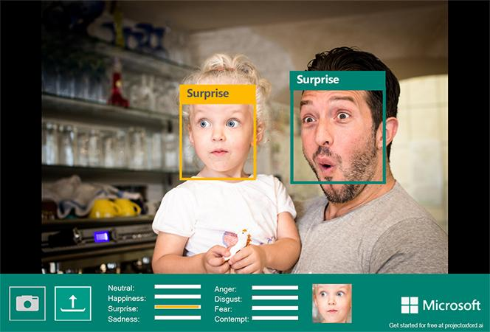
Emotion Detection
Presentation Title
*
Applications
Smart home automation
Self-driving cars
Improving classroom dynamics
Helping people with disabilities
Notes:
‹#›

Slide 3
Project Setup
Problem: Given the image of a person → classify the emotion
Solution:
Support Vector Machines(SVMs)
Convolutional Neural Networks (CNNs)
Assumptions:
Individual images express only one emotion
Challenges:
Complexity of human emotion

Slide 4
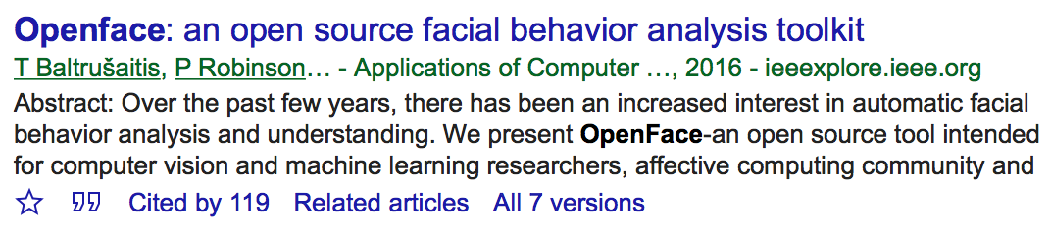
OpenFace
State-of-the-art open-source facial analysis tool
We used the Docker version of OpenFace Cambridge
Creates facial landmarks, gaze direction, and facial action units
https://github.com/TadasBaltrusaitis/OpenFace

Slide 5
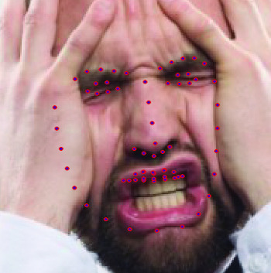
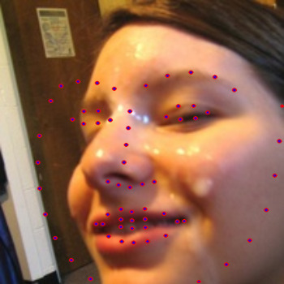
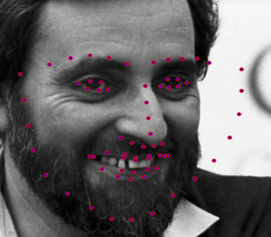
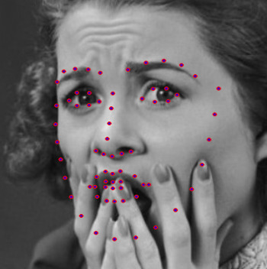
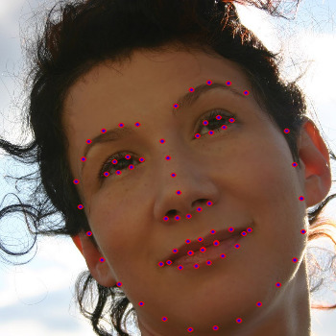
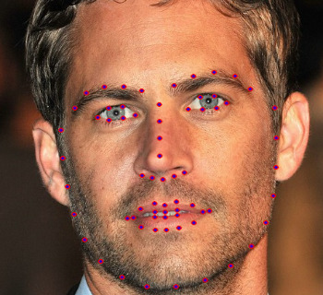
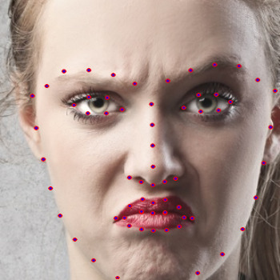
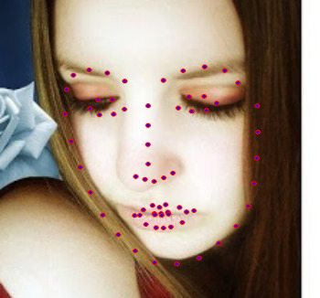
68 Landmarks Detected by OpenFace
Incorrect estimations
AffectNet Dataset
Correct estimations

Slide 6
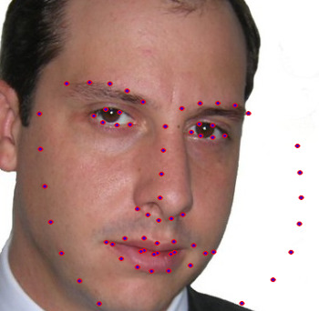
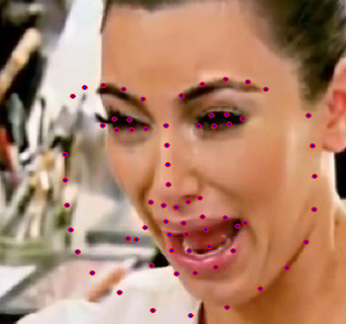
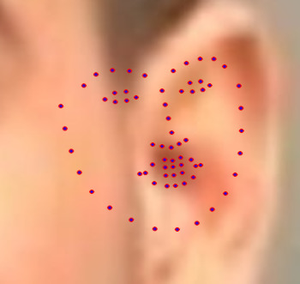
Challenges
Sometimes landmarks are not detected correctly (OpenFace problem).
Extra low-resolution images (as in FER2013).
Images with no face randomly in face datasets (AffectNet).
Images with watermarks (as in FER2013)
Some datasets have low number of images not suitable for deep learning (KDEF).

Slide 7
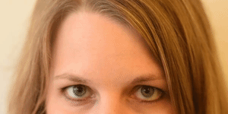
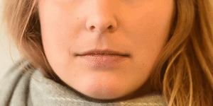
(Facial) Action Units (FAU/AU)
AU 1: Inner Brow Raiser
AU 12: Lip Corner Puller
OpenFace provides AU Intensity and Occurrence values
https://imotions.com/blog/facial-action-coding-system/

Slide 8
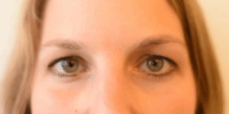
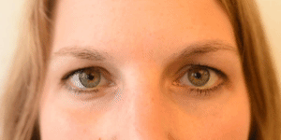
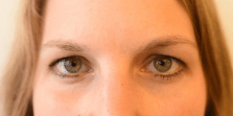
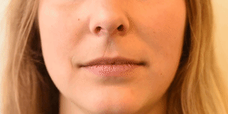
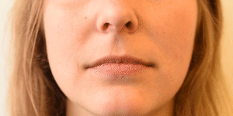
AUs contributing to Emotions
Multiple AUs form an emotion.
Happiness AUs: 6+12
Sadness AUs: 1+4+15

Slide 9
Datasets
DataSet | Source | # of images | Setup | Categories
FER-2013 | ICML 2013 challenge [1] | 35,887 | Wild | 7 emotions
KDFE | Karoliska Institutet [3] | 4,900 | Studio | 7 emotions
Why FER2013?
Wildly used in emotion recognition community
Why KDFE?
Images are more similar to the debate images we are predicting on

Slide 10
Multi-class Support Vector Machines Results
Input: vector with AU intensities and occurrences
5200 vectors for FER2013
3022 vectors for KDFE
Emotion classes: angry, disgust, fearful, happy, sad, surprised and neutral.
DataSet | Training set | Validation set | Accuracy | F1 score
FER-2013 | 4420 images | 780 images | 45.3% | 0.4218
KDFE | 2568 images | 453 images | 67.4% | 0.6709

Slide 11
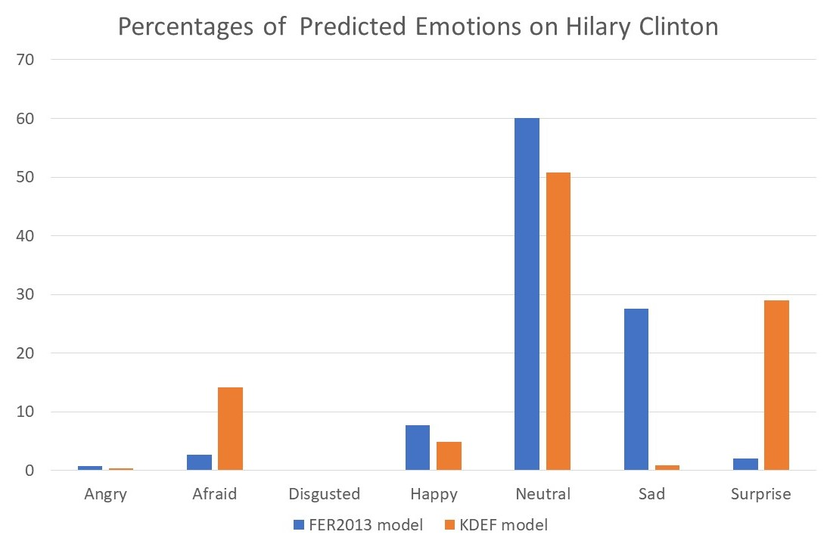
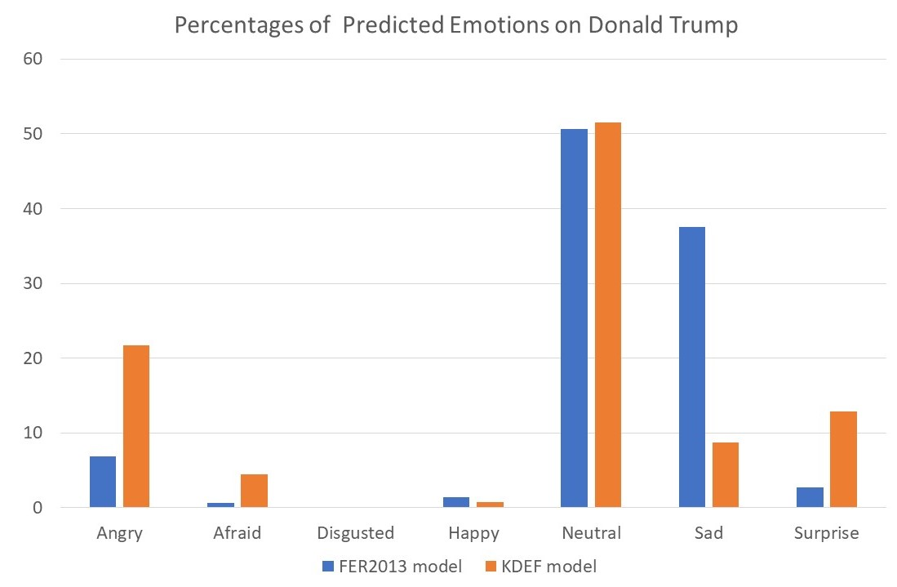
Comparison of Classification Results
Ran on a sample of 1372 frames from the debate

Slide 12
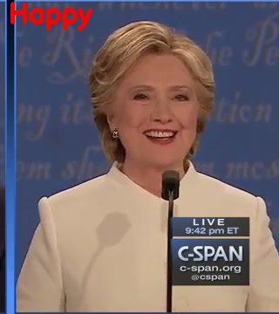
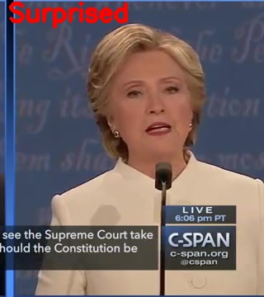
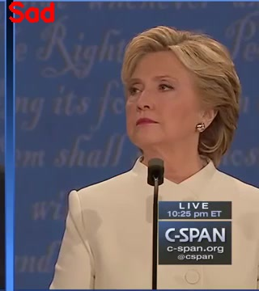
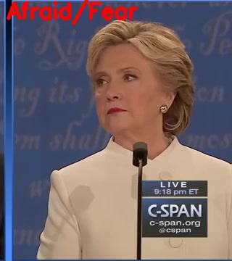
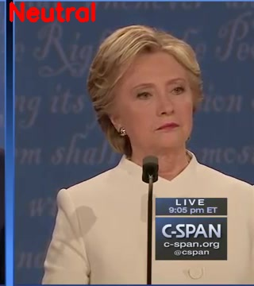

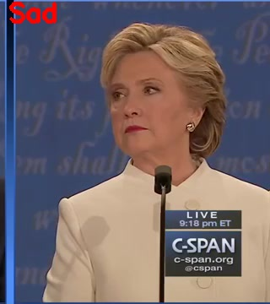
Classification Results
Top KDFE - Bottom FER2013

Slide 13


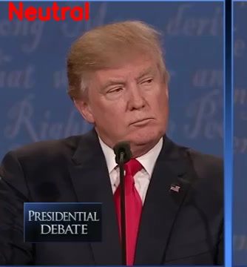
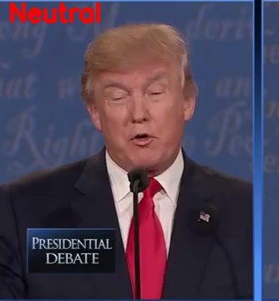


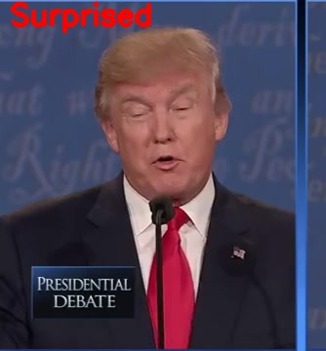
Classification Results
Top KDEF - Bottom FER2013

Slide 14
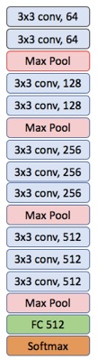
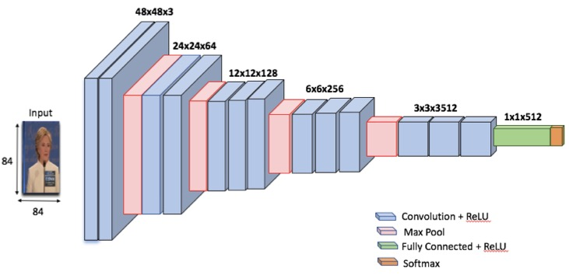
Convolutional Neural Network Architecture
Convolutional Neural Network architecture for emotion classification (VGG16)

Slide 15
Convolutional Neural Network
Datasets
Image Augmentation
Image rotation
Vertical shift
Horizontal shift
DataSet | Source | # of images | Setup | Categories
FER-2013 | ICML 2013 challenge [1] | 35,887 | Wild | 7 emotions
AffectNet | A. Mollahosseini et. al [2] | 1, 000, 000 | Wild | 8 emotions

Slide 16
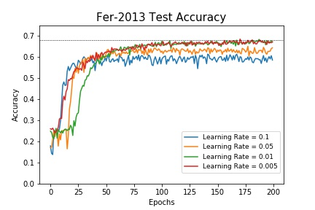
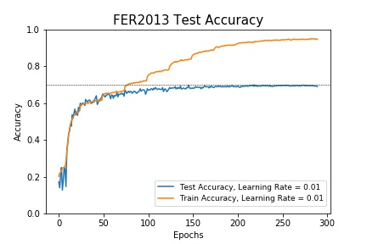
CNN - FER2013 Results

Slide 17
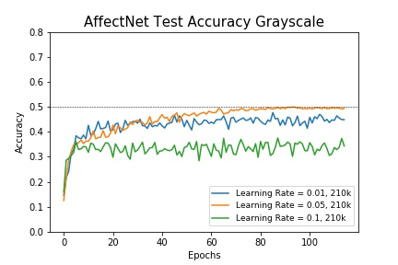
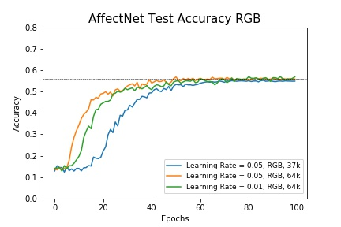
CNN - AffectNet Results

Slide 18
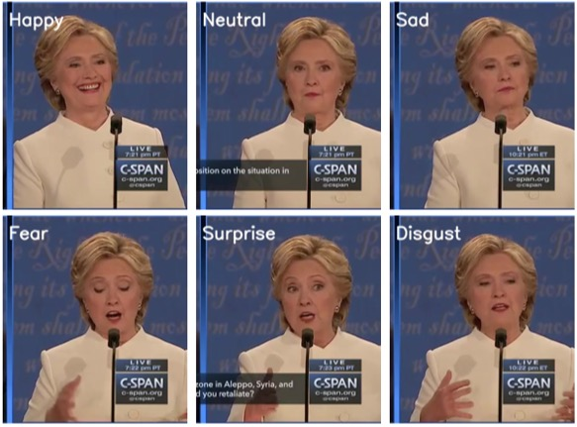
CNN - FER2013 Classification Results

Slide 19
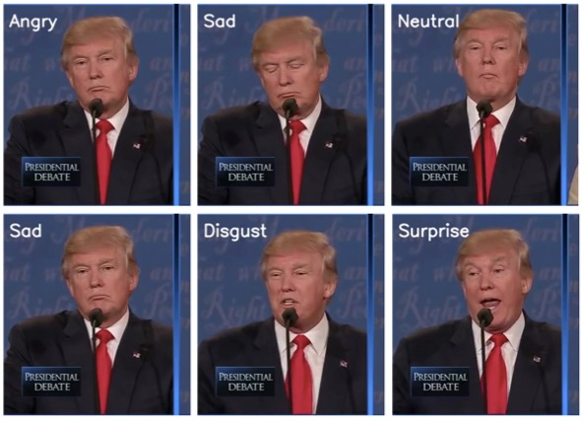
CNN - FER2013 Classification Results

Slide 20


CNN - FER2013 Results Videos

Slide 21
Conclusion
CNNs perform better than action units/SVM for FER-2013
Hyper-parameter tunings for the CNNs affect our results significantly.
Results from one dataset to another one are not transferable by default.

Slide 22
Future Work
Emotion detection using Recurrent Neural Networks(RNN).
Using multi-modal classifier incorporating voice, and video signals besides the still images from video.
Using domain adaptation for detecting emotion in caricature, sketch and animation images.
Group-level emotion detection using EmotiW 5.0 dataset.

Slide 23
References
Kaggle FER2013 Challenge, https://www.kaggle.com/c/challenges-in-representation-learning-facial-expression-recognition-challenge/data, 2013.
A. Mollahosseini, B. Hasani, and M. H. Mahoor, AffectNet: A New Database for Facial Expression, Valence, and Arousal Computation in the Wild, IEEE Transactions on Affective Computing, 2017.
Lundqvist, D., Flykt, A., & Öhman, A. (1998). The Karolinska Directed Emotional Faces - KDEF, CD ROM from Department of Clinical Neuroscience, Psychology section, Karolinska Institutet, ISBN 91-630-7164-9.

